Slide 1
Employee Data Analysis using Excel
STUDENT NAME:KAMATCHI
REGISTER NO:312201626
DEPARTMENT:COMMERCE
COLLEGE:prof.Dhanapalan college of science and Management

Slide 2
PROJECT TITLE
Employee Performance Analysis using Excel

Slide 4


AGENDA
Problem Statement
Project Overview
End Users
Our Solution and Proposition
Dataset Description
Modelling Approach
Results and Discussion
Conclusion
3/21/2024 Annual Review

Slide 5
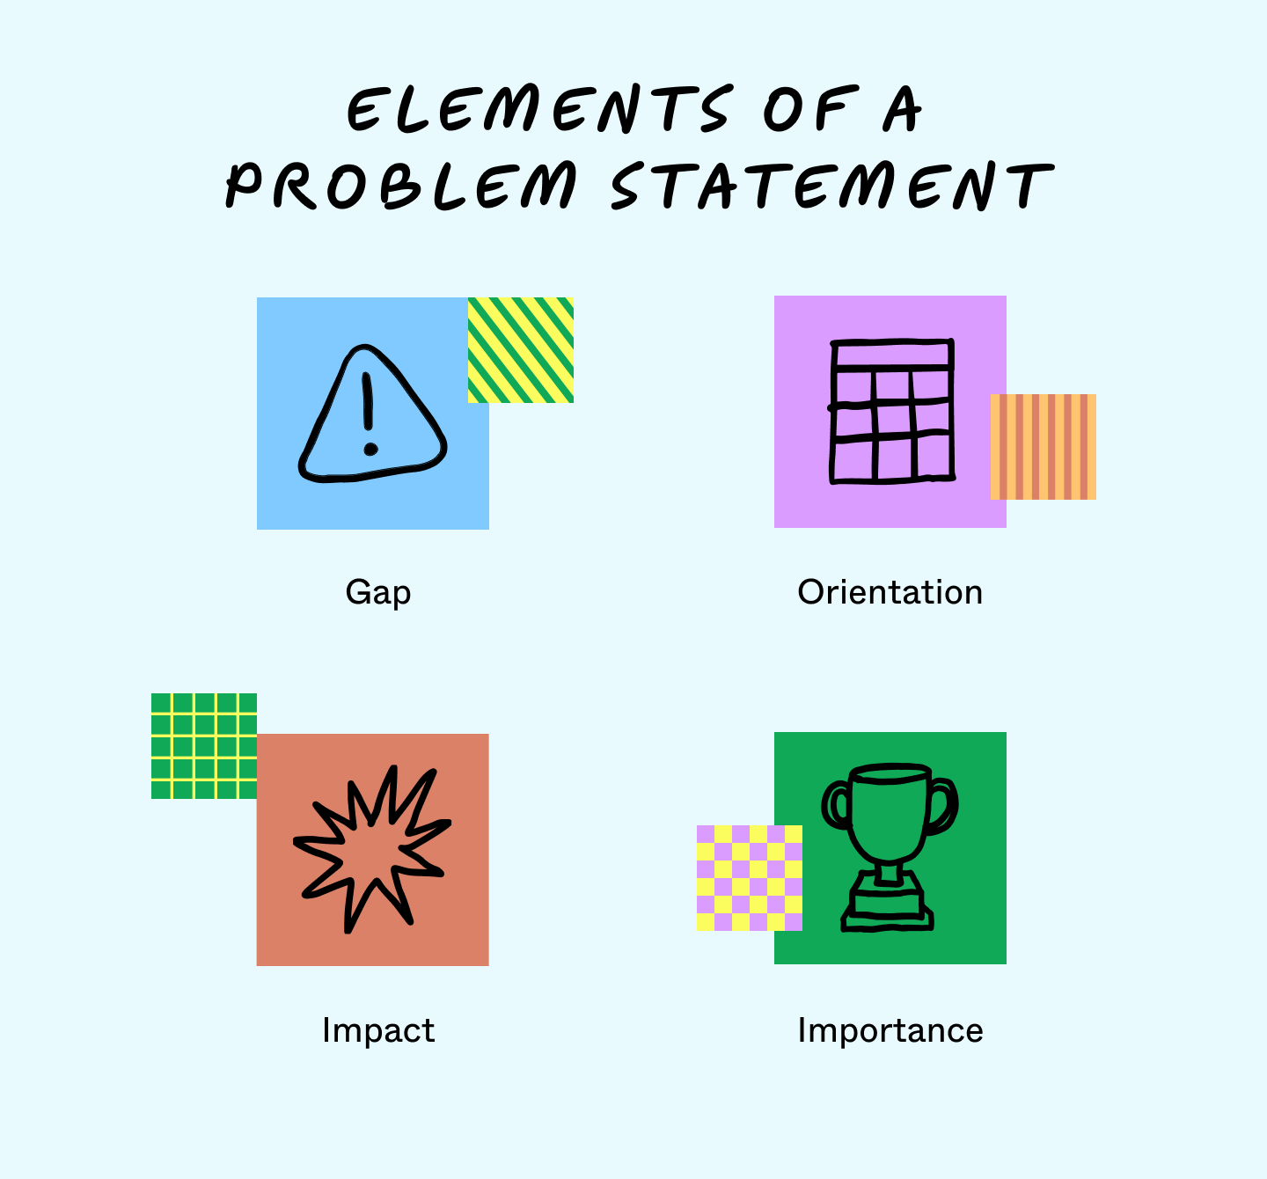

PROBLEM STATEMENT
problem statement is a description of an issue to be addressed. or a condition to be improved upon. It identifies the gap between the current problem and goal. The first condition of solving a problem is understanding the problem, which can be done by way of a problem statement.[1]

Slide 6
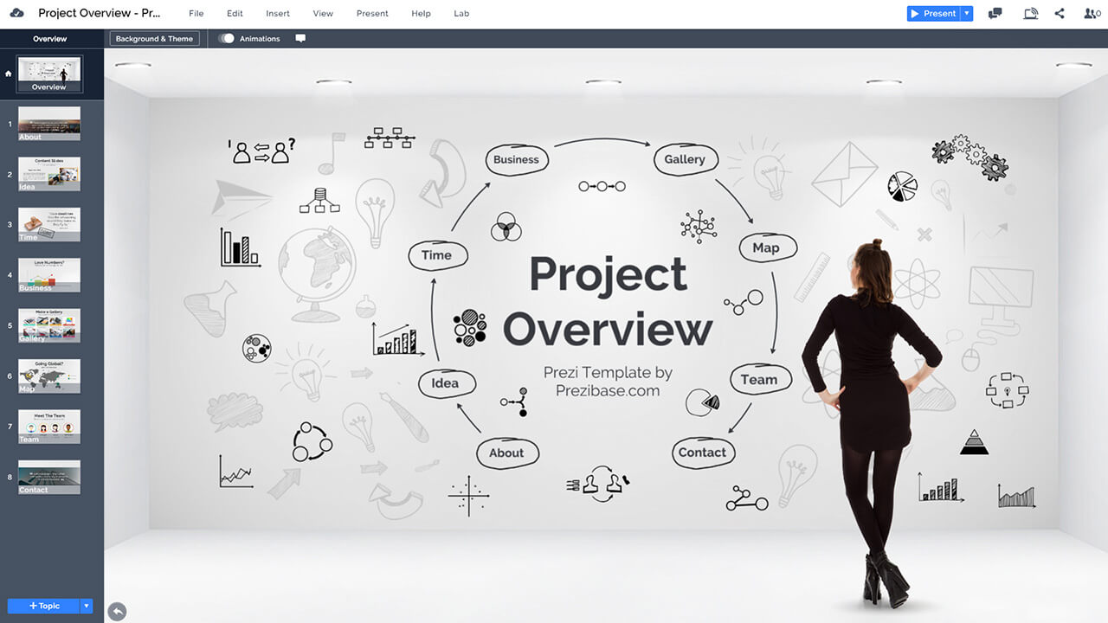

PROJECT OVERVIEW
project overview is a detailed description of a project's goals and objectives, the steps to achieve these goals, and the expected outcomes. In addition, a project overview enables you to outline the project schedule, budget, necessary resources, and status
.

Slide 7
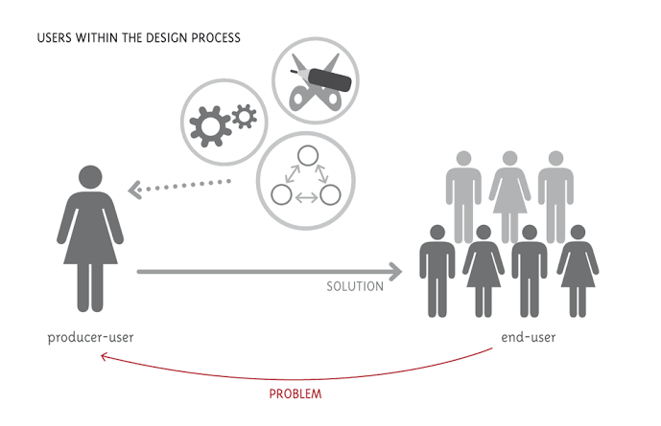

WHO ARE THE END USERS?
Ultimately, an end user is a person who will use a good or service. End users are consumers. They do not produce, sell, support, or maintain the product. These people often do not have the same technical understanding as the product’s designers and developers.

Slide 8

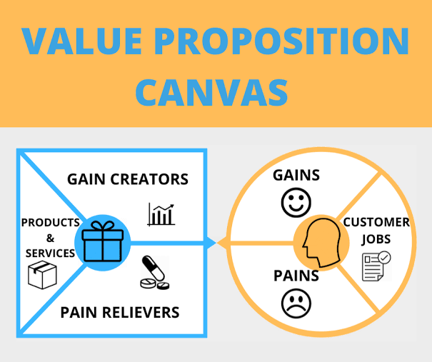
OUR SOLUTION AND ITS VALUE PROPOSITION
A value proposition is a short statement that communicates why buyers should choose your products or services. It's more than just a product or service description — it's the specific solution that your business provides and the promise of value that a customer can expect you to deliver

Slide 9
Dataset Description
A Dataset is a set or collection of data. This set is normally presented in a tabular pattern. Every column describes a particular variable. And each row corresponds to a given member of the data set, as per the given question. This is a part of data management.

Slide 10
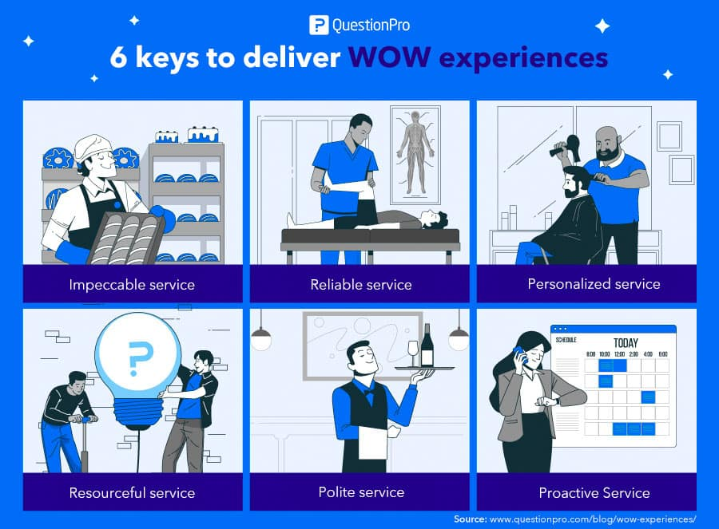

THE "WOW" IN OUR SOLUTION
"WOW the Customer" refers to exceeding customer expectations by delivering exceptional experiences that leave a lasting positive impression. It involves going above and beyond in providing excellent service, personalized attention, and solving customer problems in unexpected and delightful ways.
3/21/2024 Annual Review
10

Slide 11
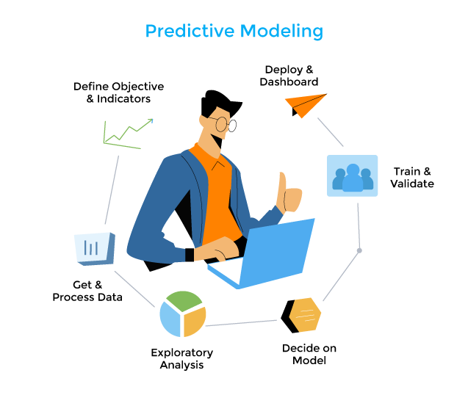
MODELLING
Modeling involves making a representation of something. Creating a tiny, functioning volcano is an example of modeling. Teachers use modeling when they have a class election that represents a larger one, like a presidential election. Modeling is anything that represents something else, usually on a smaller scale.
11

Slide 12
RESULTS
A result is also the answer to some problem, especially one obtained by calculation or experimentation. The result you get for a math problem will be wrong if you add when you should multiply. The verb result means to follow as an outcome of some action. If you forget to book a room in advance, it will result in your having to stay at the hotel by the airport instead of one by the beach.
12

Slide 13
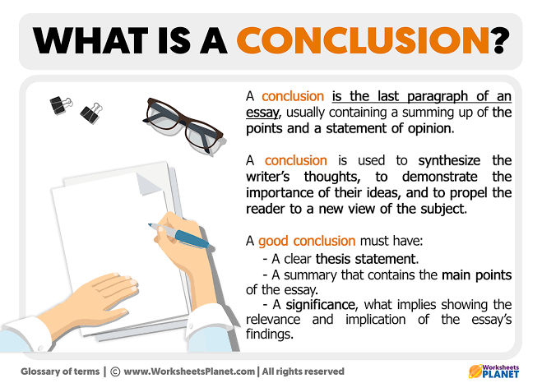
conclusion

